Slide 1


Decorator Pattern

Slide 2

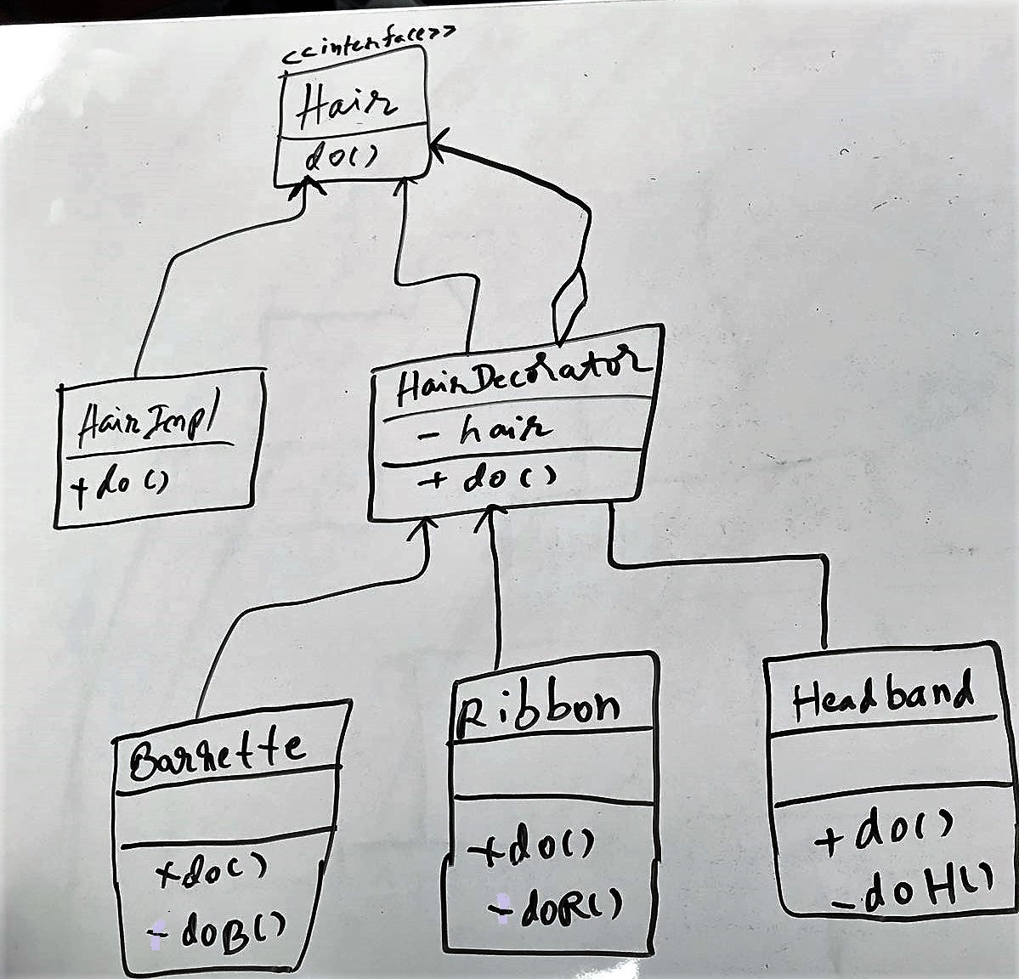
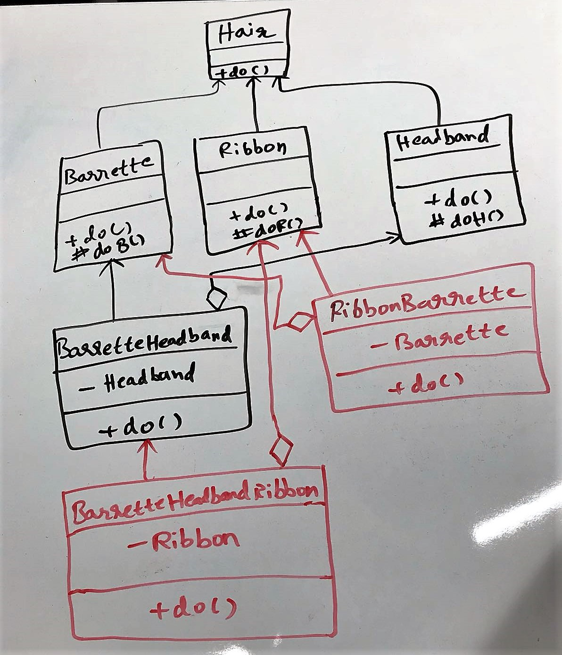
With Decorator
Without Decorator

Slide 3
Decorator Pattern
Dynamically add or remove the behavior or state of the object (without subclassing).
Reduces the overhead involved with multiple levels of inheritance.
Reduces tight coupling between classes.
Provides a flexible way to create new behavior (by letting users specify their desired combination).

Slide 4

References
https://www.baeldung.com/java-structural-design-patterns

